Slide 1

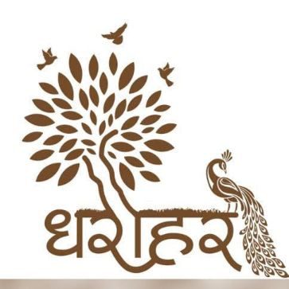
Heritage and culture of Chhattisgarh
Madhurima Rawat
Datascience(B.Tech CSE)
Dharohar Club UTD CSVTU

Slide 2
About chhattisgarh
Chhattisgarh is one of the ancient states of India.
Chhattisgarh borders associated the states of Maharashtra, Madhya Pradesh, Andhra Pradesh, and Telangana.
The Chhattisgarhi culture is immersed in varieties of dance forms, mainly due to the number of tribes residing in the vast expanse of the state.
The state’s tribal population has developed many native indigenous folk performances of their cultural beliefs.
Most of the Chhattisgarh folk dance forms are performed as part of rituals, performed in reverence for the gods or denoting the change of seasons.
Special costumes and accessories are made for such dance forms and the fast movements combined with perfect timing will leave you mesmerized.

Slide 3
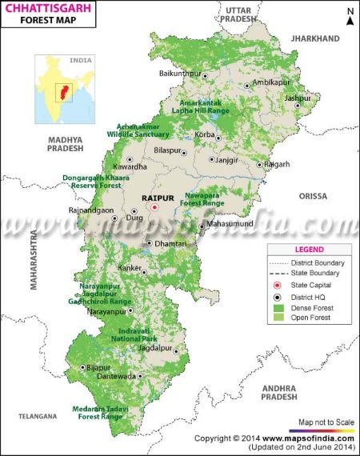
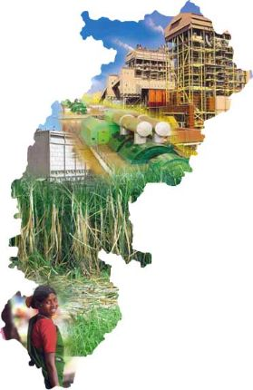
Map of chhattisgarh

Slide 4
Tribal and folk dances of chhattisgarh
Tribal Dances
Folk Dances
Saila Dance
Panthi Dance
Karma Dance
Bison Horn Maria
Sua Nacha
Raut Nacha
Rahas Dance
Pandwani

Slide 5
Tribal dances
Let’s start with tribal dances

Slide 6
Tribal dances-Culture & Heritage
The tribal people preserve their rich culture modestly and religiously.
Chhattisgarh has been home to many tribals.
It is believed that the ancient tribals were living in Bastar for more than 10000 years.
The main tribal community of Chhattisgarh state includes Bastar – Gond, Bisonhorn Maria, Muria, Halba, Bhatra, Parja, Dhurva,Dantewara – Muria, Dorla, Halba,Korea – Kol,Savra, Rajgond, Kavar, Dhanwar , Bilaspur and Raipur – Parghi, Savra, Manji,Mainpur, Dhura,and Jashpur – Munda.
The state hosts many religious sects such as Satnami Panth, Kabirpanth, Ramnami Samaj, and others.
There are over 35 big and small colourful tribes spread over the region.

Slide 7
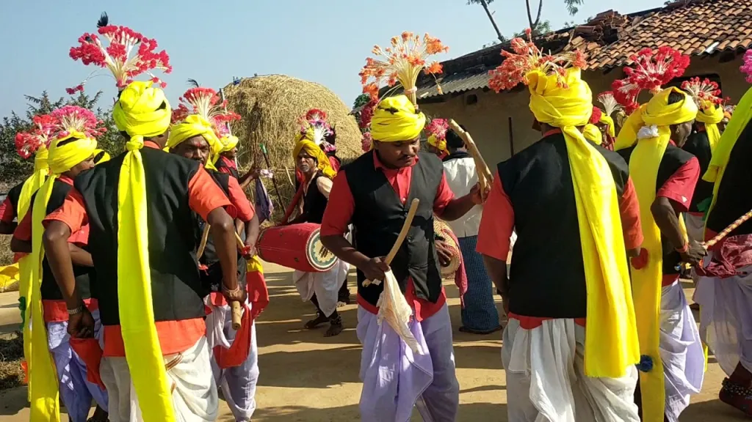
Saila Dance
This Chhattisgarh dance form is performed by boys
after the harvest season.
This stick dance involves children who move in
various styles while tapping their stick against the
stick of the person next to them.
Villagers give paddy to people who participate in the dance as a sign of gratitude.
The pinnacle of this interesting gait structure is usually a snake dance.

Slide 8
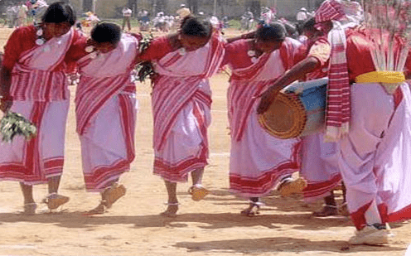
Karma Dance
Generally performed by tribal groups like
Gonds andBaigas in Chhattisgarh.
This dance form marks the end of the rainy season
and the advent of spring.
Both men and women participate in the
dance following a lead singer.
It is only after the offering of new to the
deity on the second day that its consumption begins.
Karma dance is to celebrate the arrival of a
new crop.

Slide 9
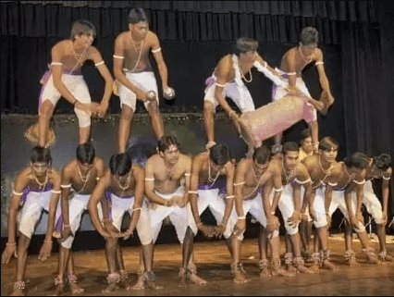
Panthi Dance
The Satnami community celebrates the anniversary
of the birth of Guru Ghasidas in Maghi Purnima.
The dance also combines a variety of steps and
patterns and generally denotes the teachings and
sayings of its holy master.
The dancers wear colorful dresses and
sing praises to the “guru”.
A group of men builds a pyramid formation as the group leader sings.

Slide 10
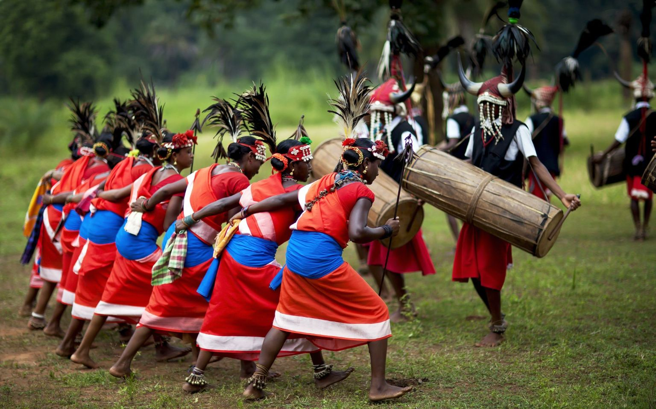
Bison horn maria
This dance is performed during festivals as part of
worship or related to agriculture and marriage.
Earlier the men used to do the drumming as part
Of hunting exercise.
The heavy cylindrical drum is made of a hollowed
tree-trunk three feet or more in length.
The Bison Horn Maria dance is a synchronous rhythmic dance.

Slide 11
Folk dances
Now let’s move to folk dances

Slide 12
Folk dances-Culture & Heritage
Chhattisgarh is rich in its cultural heritage.
The State has a very unique and vibrant culture.
Their rhythmic folk music, dances and dramas are a treat to watch and also provide an insight into the culture of the State.
Most of the Chhattisgarh folk dance forms are performed for denoting the change of seasons, as part of rituals or are performed in reverence for the gods.
To make these performances even better, special costumes as well as accessories are designed for them

Slide 13
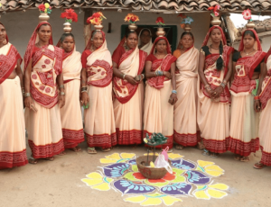
Sua Nacha
Usually called a parrot dance.
This dance is done on Goura-Gauri wedding in Diwali.
Women of the devaar tribe perform this dance.
The artists also sing and move, accompanied by loud
applause.
Firstly, the women perform this dance and while doing
So, keep a clay parrot in the center.

Slide 14
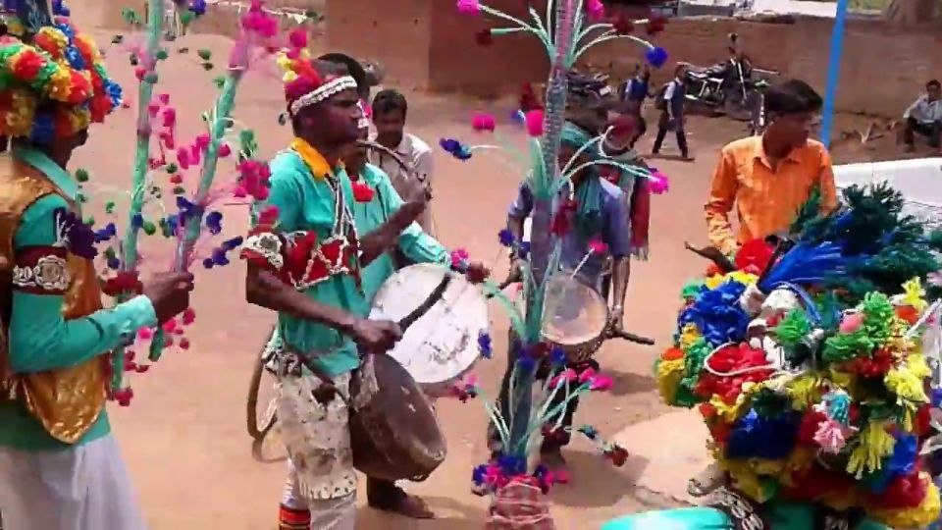
Raut nacha
The scenes show the fierce fight
between King Khansa and the cowboys in
that area.
The cowboy Yadavs represent Lord
Krishna as their almighty.
As per the Hindu calendar, on the 11th
day after the Deepawali known as ‘dev
udhniEkadashi’,this dance take place.
It is a strong belief that during the auspicious ‘tithi’ the god is awake.

Slide 15
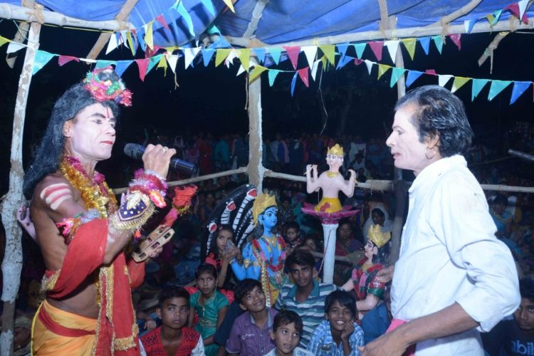
Rahas Dance
The Rahas dance is performed during festivals
in Chhattisgarh.
It is a important folk dance performed in the
Dhamtari district of the state.
Rural people represent the dance with great
enthusiasm wearing traditional hats and costumes.
The central theme of the dance is Rasa Lila of Krishna and his
abode Radha.

Slide 16
About Pandwani
Actually, the Pandwani singer is a genre of telling the story of Mahabharata in Chhattisgarhi. In which the whole story is told with songs and verses.
Pandavani (Songs and Stories of the Pandavas) is a folk singing style involving narration of tales from the ancient Indian epic Mahabharata.
The singing also involves musical accompaniment. Bhima, the second of the Pandava is the hero of the story in this style.
This form of folk theatre is popular in the central Indian state of Chhattisgarh and in the neighbouring areas of Madhya Pradesh, Orissa and Andhra Pradesh.

Slide 17
Types of pandwani
Vedamati
Singing
Kapalik
Singing and Dancing

Slide 18
Some prominent pandwani singers
TODAY WE ARE GOING TO DISCUSS ABOUT MRS TEEJAN BAI AND MRS. USHA BARLE.

Slide 19
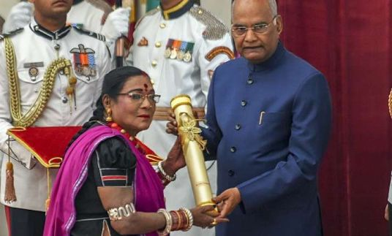
Mrs. Teejan bai receiving padmaVibhusan from Hon. president of india

Slide 20
Mrs. Teejan bai
Beginning of Pandwani singing
She used to watch her maternal grandfather Brajlal sing stories from Mahabharata and gradually she started remembering these stories.
At the age of 13, she made her first stage performance.
In those times, female Pandwani singers could only sit and sing what is called the Vedmati style.
Earlier, men used to stand up and sing in Kapalik style.
Teejanbai was the first woman who performed Pandwani in the Kapalik style.
She was expelled from the community by the 'Pardhi' tribe for being a woman, for singing Pandwani.

Slide 21
Awards received by mrsTeejan Bai
She is the first female artist of folk song-drama Pandwani in Chhattisgarh state of India.
In 1980, as a cultural ambassador, she travelled to England, France, Switzerland, Germany, Turkey, Malta, Cyprus, Romania and Mauritius and performed there.
She was awarded the Padma Shree by the Government of India in the year 1988 and the Padma Bhushan in the field of art in the year 2003.
She has also been awarded Sangeet Natak Akademi Award in 1995 and the Nritya Shiromani Award in 2007.
In 2019, she was awarded the Padma Vibhushan by Hon. President Shri Ram Nath Kovind.

Slide 22
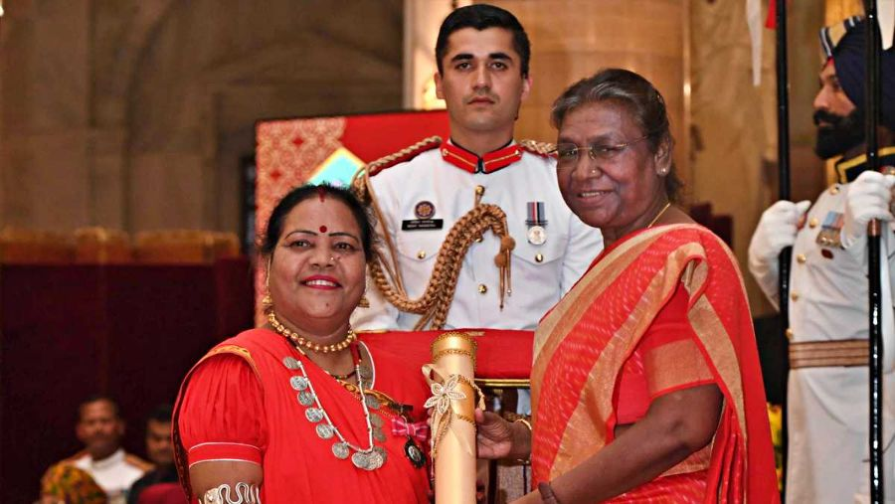
Mrs Usha Barle Receiving Padma Shree From Hon. President Of India

Slide 23
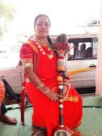
About Usha Barle
From the age of 7, she came into the field of this art. Since then she is singing Pandwani.
She has received training in Pandwani
from renowned Pandwani singer and
Padma Vibhushan Teejanbai.
She has performed Pandwani in various
states of India including cities like London
and New York.

Slide 24
Struggles
Usha Barle says that she also went through a period of financial constraints.
When she remember that time, her eyes become moist.
She used to sell bananas, oranges and other fruits in a sector-1 settlement to run the household.
They were very struggling days. Even after this, she did not give up.
Her husband studied ITI and then got a job at BSP. After this her financial conditions improved.
The Government of India has selected her for the Padma Shri award for her good work in the field of Pandwani.

Slide 25
Career
Usha Barle says that from the age of 7, she started getting interested in Pandwani singing. For this, his guru first became his uncle.
Usha Barle told that her uncle encouraged her and her uncle had said that one day you will brighten the name of your village as well as your state and country, today her dream has been fulfilled.
She says that the state government should open a school for the education of Pandwani, in which the interested children of Pandwani can be educated.
So far, Usha has performed her Pandwani genre in more than 45 countries along with India.

Slide 26
Awards
She was conferred with the Padma Shree the third highest civilian honour.
Along with this, she has been honored with Dau Mahasingh Chandrakar Award by bhilai steel plant management.
For Pandwani she has been awarded Guru GhasidasSamajik Chetna Puraskar by the Government of Chhattisgarh.
She has also been awarded gold medals six times in Girodhpuri Tapobhoomi.

Slide 27
Foods of chhattisgarh
BEING A STATE WHICH PRODUCES STAPLE FOOD IN ABUNDANCE, A GREAT PART OF THE FOOD CULTURE OF CHHATTISGARH CONSISTS OF THE STAPLE CROPS SUCH AS RICE, BAJRA, JAWAR.

Slide 28
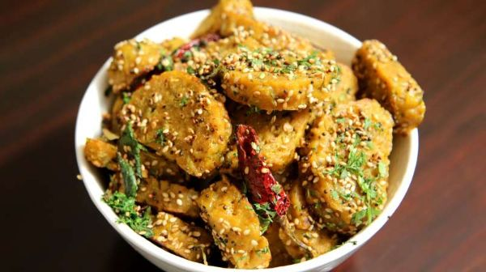
Muthia
Muthia are dumplings cooked in the traditional style
of the Chhattisgarh state.
Muthia is prepared with the rice batter which is
seasoned with various spices.
The dish is not fried but is steamed and hence it
retains the original flavor of its ingredients.
This dish is also famous among the rural people of the state.

Slide 29
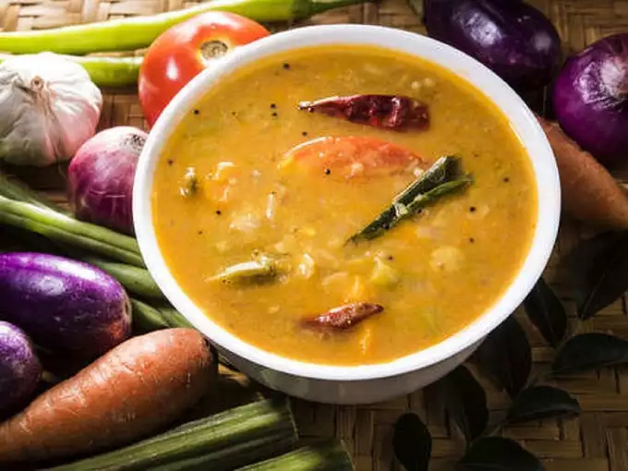
Aamat
Aamat is considered as the Sambhar of Bastar
region of the state.
This delectable delicacy of the state is
prepared with mixed vegetables which is cooked
along with the ginger garlic paste and various
spices to enhance the flavor of the dish.
Traditionally the dish is prepared in the bamboo shoots.

Slide 30

Chila
Chila is flat chapati like dish which is
prepared with the rice batter mixed with the
Urad Daal.
The dish is very easy to cook and is very
delicious in the taste.
Chila is an important part of the breakfast
meal of the people of Chhattisgarh.
To grab the best taste of Chila, complement it with the green chutney.

Slide 31
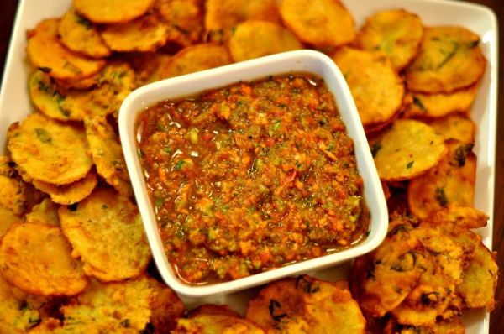
Bhajia
Bhajia is a famous street food of
Chhattisgarh which is very popular among
the local people of the state.
Bhajia is prepared with the gram flour.
Various type of Bhajis such as Mirchi Bhaji-
prepared with chili, onion Bhaji prepared with
onion, and Aloo Bhajia prepared with potato are
some of the famous variants of the dish.
The perfect aroma and the right amount spices add the delectable street food taste to this dish.

Slide 32
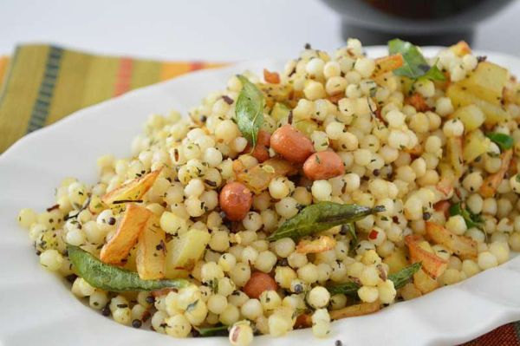
Sabudana ki Kichdi
Sabudana Ki Kichdi is a dish prepared with the
soaked Sabudana balls.
To add the flavor to the dish various vegetables
and spices are added that provides a delicious taste.
Sabudana ki Kichdi is fondly eaten during
the fast, but it accounts for an important dish for the
people of Chhattisgarh.

Slide 33
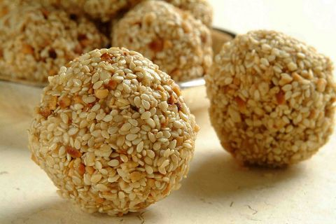
Tilgur or tilkeladoo
The roasted sesame seeds are mixed with the
dark jaggery and peanuts.
The mixed is well mixed and is then made into
Ladoos to grab the famous dish of the state.
Tilgur are must- served during the various
Occasions and festivals of the state.
Makar Sankranti is the main festival where the people prepare Tilgur.

Slide 34
Art and Crafts
let’s take a look at the art and crafts of chhattisgarh

Slide 35
Tribal Art
The tribal art of Chhattisgarh includes wall painting and
pithora art

Slide 36
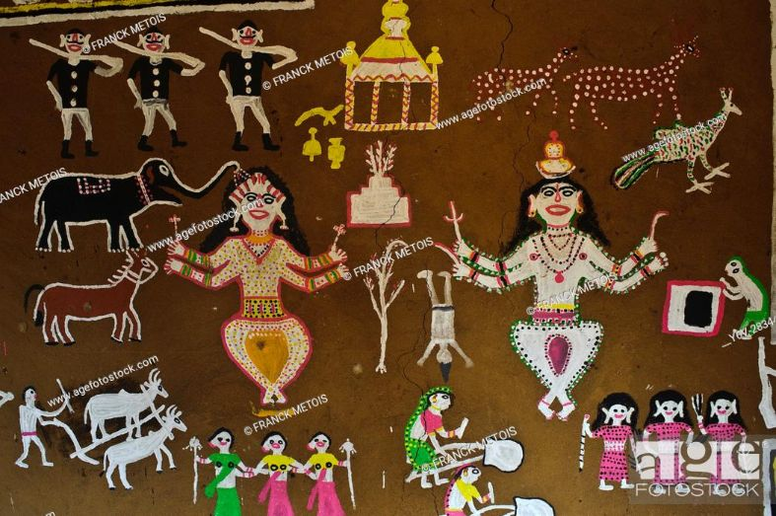

Slide 37
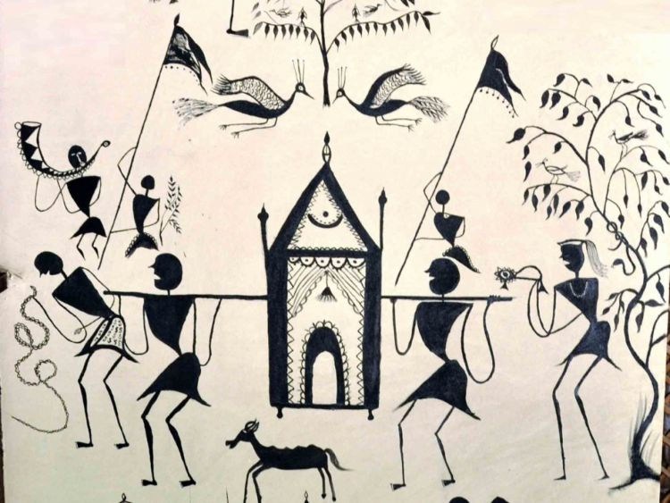

Slide 38
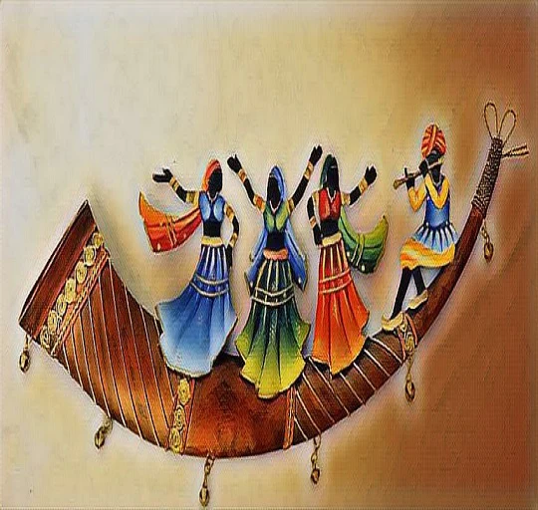

Slide 39
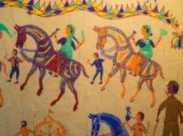

Slide 40
Crafts of Chhattisgarh
The crafts include metal carving , wood carving, bead carving , wall art

Slide 41
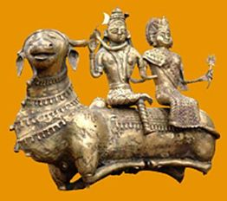

Slide 42
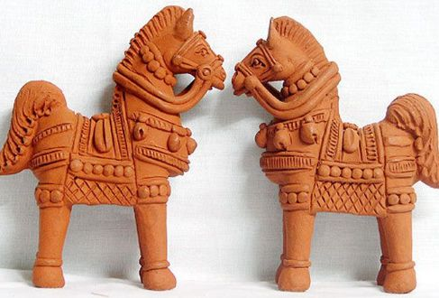

Slide 43
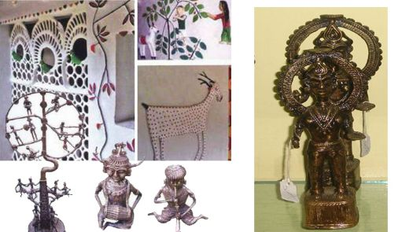

Slide 44
Art and crafts
Chhattisgarh is renowned for rich metal crafts and other handicrafts made of bamboo and wood.
Folk painting and folk jewelry of Chhattisgarh are very popular.
The painting depicts the living style of the tribal people of which Fork Art Painting and Pithora paintings are very popular.
Tribal men and women of Chattisgarh wear traditional folk ornaments made out of beads.
Overall, Bamboo work, Woodcarving, Fork Art Paintings, and folk Jewelry are the primary forms of handicrafts in Chattisgarh.

Slide 45
Freedom fighters of chhattisgarh
THE INTRUSION OF THE BRITISH WAS RESISTED STRONGLY IN BASTAR BY THE TRIBALS AND OTHERS PART OF CHHATISGARH AND IT CONTINUED TILL 1947.

Slide 46
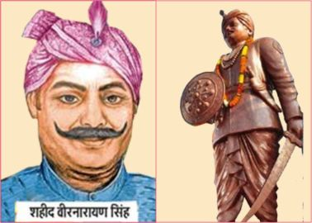
Veer Narayan Singh
Veer Narayan Singh (1795–1857) was a landlord from
Sonakhan, Chhattisgarh.
He spearheaded the 1857 war of Indian independence in
Chhattisgarh.
He is also known and considered as "The 1st Chhattisgarhi
freedom fighter".
His ancestor were from Gond tribal group and were residing
in Bhangad.
Later on, they changed their affiliation from Gond tribe and moved to Sonakhan in Raipur district.
He was hanged at Jaistambh Chowk of Raipur, Chhattisgarh.

Slide 47
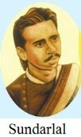
Pt. Sundarlalsharma
Pandit Sundarlal Sharma (21 December 1881 — 28 December 1940)
was a key figure in the independence movement from Chhattisgarh.
He was largely responsible for ushering in political and social
consciousness to Chhattisgarh.
In 1920, he started the canal satyagraha, also known as the Nahar
satyagraha, at a village called Kandel in DhamtariTehsil.
Chhattisgarh has a university in the name of Pandit Sundarlal Sharma.

Slide 48
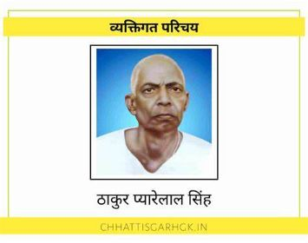
Thakur Pyarelal singh
Thakur Pyarelal Singh (21 December 1891 -20 October 1954), was an
Indianfreedom fighter against British rule and the founder of labour
movements in Chhattisgarh.
He led three workers' movements in RajnandgaonRiyast in 1919-1920,
1924 and 1937.
Many Indian national schools were established during this period under Thakur Pyarelal's supervision, including the Madhyamik School in Rajnandgaon.
He was also conferred with the honorary title of "Tyagmurti", which means "epitome of sacrifice“.

Slide 49
Ram Van Gaman Tourism Circuit
IT IS TO UNDERPIN THE LEGACY OF LORD RAM THAT THE CHHATTISGARH GOVERNMENT HAS COME UP WITH THE IDEA OF DEVELOPING THE RAM VAN GAMAN TOURISM CIRCUIT.

Slide 50
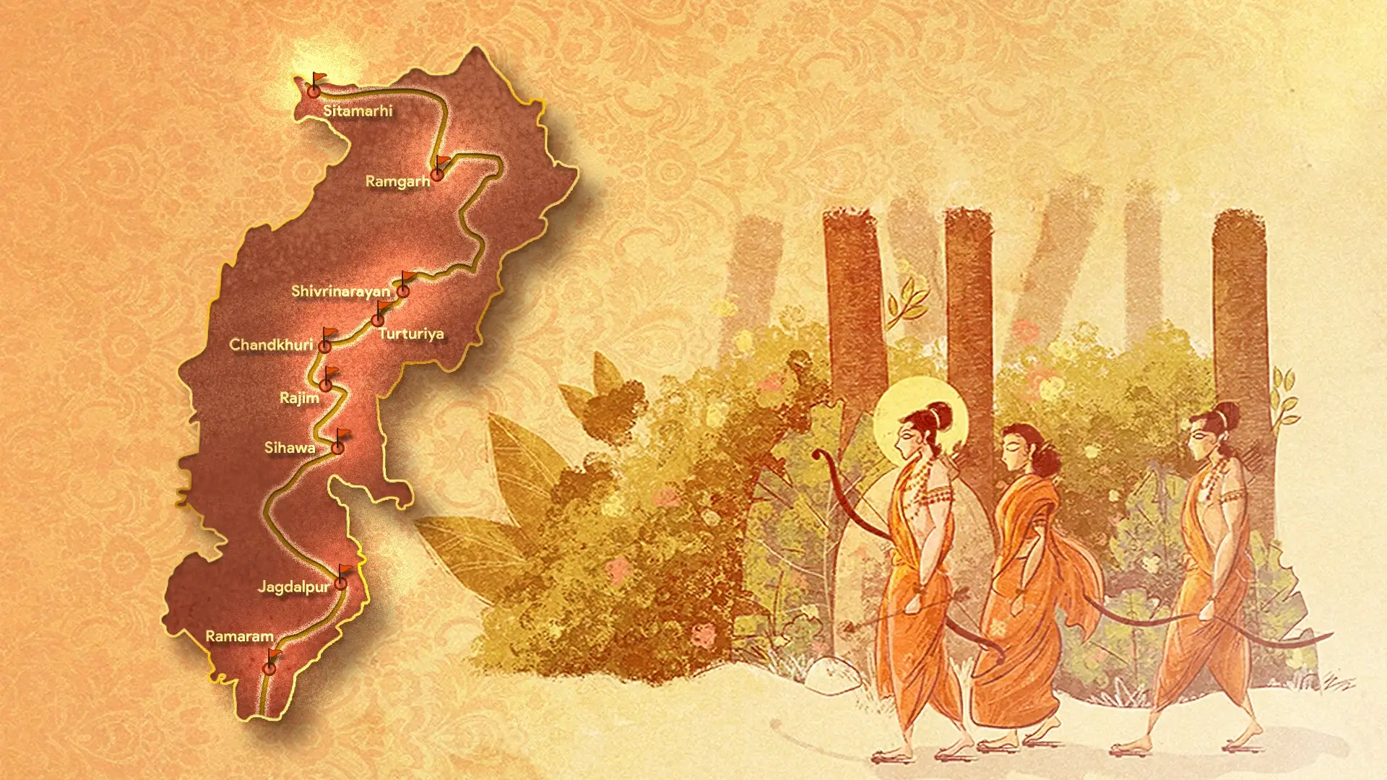

Slide 51
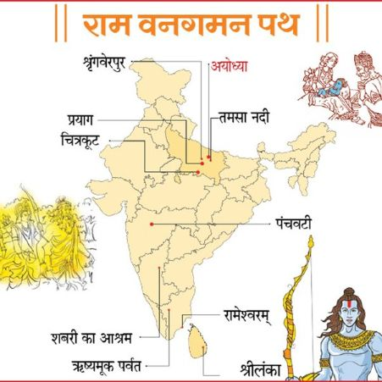

Slide 52
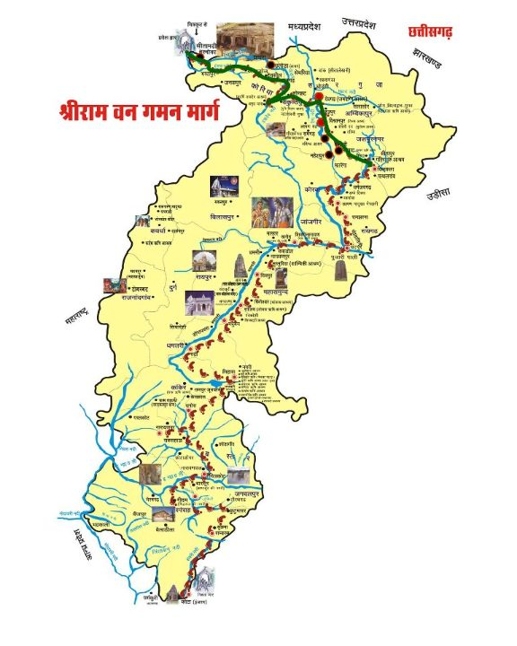

Slide 53
Historical Significance of the Ram Van Gaman Path
The Ram Van Gaman Tourism Circuit emphasizes this universal message of Ramayana by marking the path that Lord Ram had traveled in the course of his wanderings during his exile when he was accompanied by his brother Lakshman and wife Sita.
The path will identify and mark the footsteps of Lord Ram as he led the arduous life of an ascetic, away from the fame and royalty of his Ayodhya palace.
The Ram Van Gaman Path will, therefore, pay a worthy tribute to the important era in Treta Yug when Lord Ram set a glorious example of righteousness by following his father King Dashrath’s command.

Slide 54
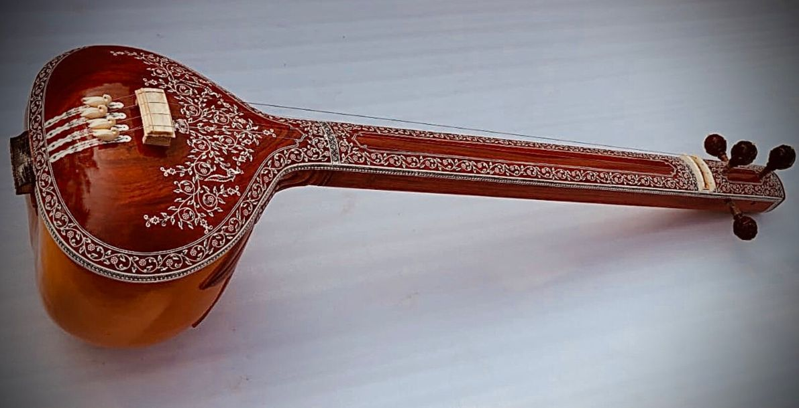
Thank You For Listening To Me

